Slide 1
Sparkly but not too sparkly!
Anti-aliasing a procedural sparkle effect
Huw Bowles Beibei Wang
SIGGRAPH 2015 Advances in Real-Time Rendering in Games
Notes:
Hello! This talk outlines a procedural sparkle effect I developed for a recent game in collaboration with my colleague Beibei Wang.

Slide 2
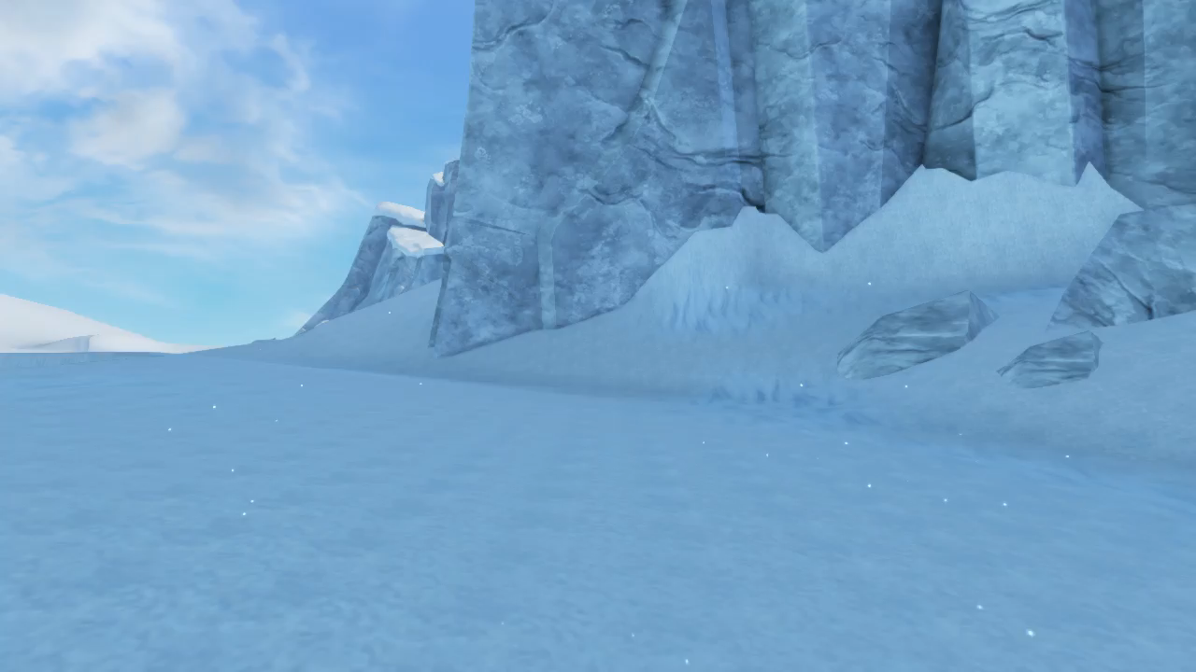
SNOW SPARKLE
Notes:
This is what the result looked like. Note we’ve artificially scaled up the size of the sparkles to make them more visible for this presentation.

Slide 3
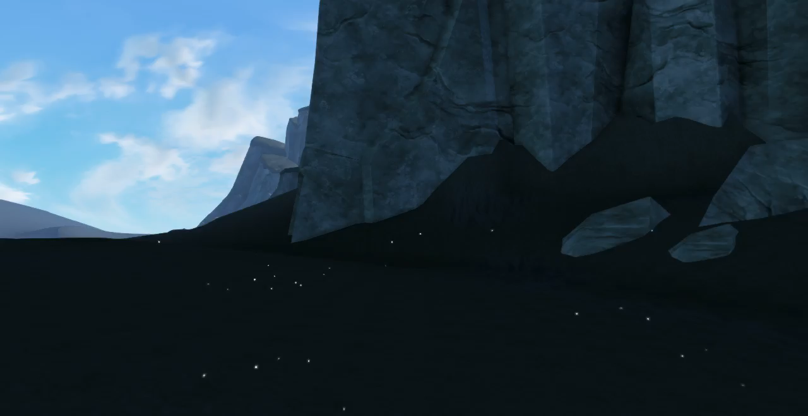
SNOW SPARKLE
Notes:
And here’s a version with the snow material knocked out to make it clearer. Note that the sparkle effect works even in the distance, which had a miniteurising effect which matched the style of our game.

Slide 4
Why procedural?
Reasonably difficult to achieve with normal maps
Wanted option to have procedural sparkles over a large depth range
Miniaturisation of scene
To work independent of lighting conditions
To be present in shadows and indoors
Notes:
The high frequency nature of the sparkles makes it inherently difficult with just normal maps and lighting. It was also desirable to not have to change existing materials or add additional normal maps etc.

Slide 5
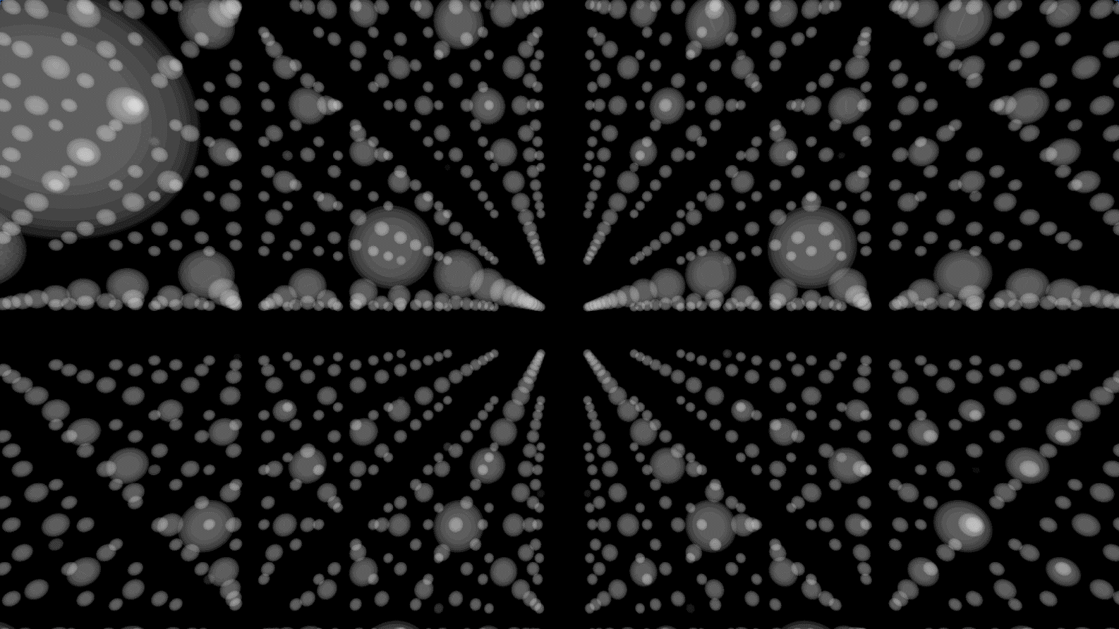
Procedural Sparkles
Algorithm from Shopf: intersect sparkle grid with surface
Notes:
The idea from Shopf is to represent the sparkles as a 3d grid of sparkle kernels.

Slide 6
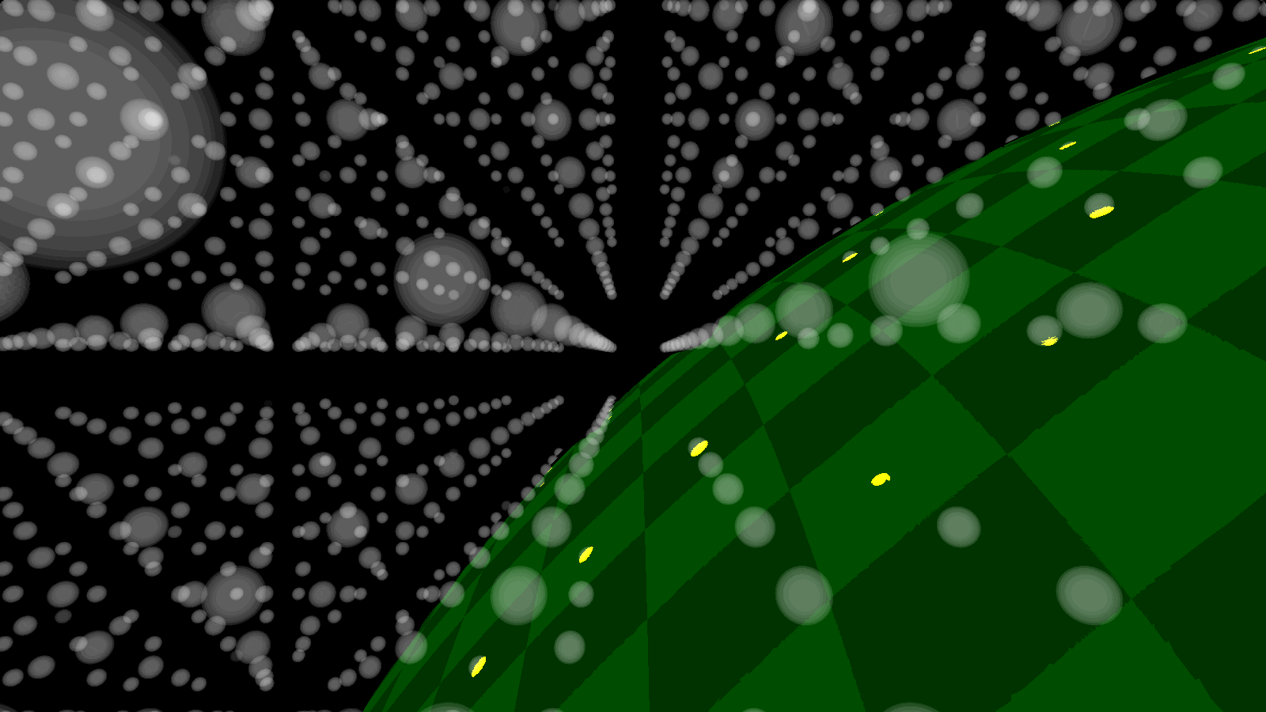
Procedural Sparkles
Algorithm from Shopf: intersect sparkle grid with surface
Notes:
When a surface is rendered, a lookup is done into the grid from the shading point, and the intersection is shaded brightly (yellow).
You can see the intersections clearly here (arrows)

Slide 7
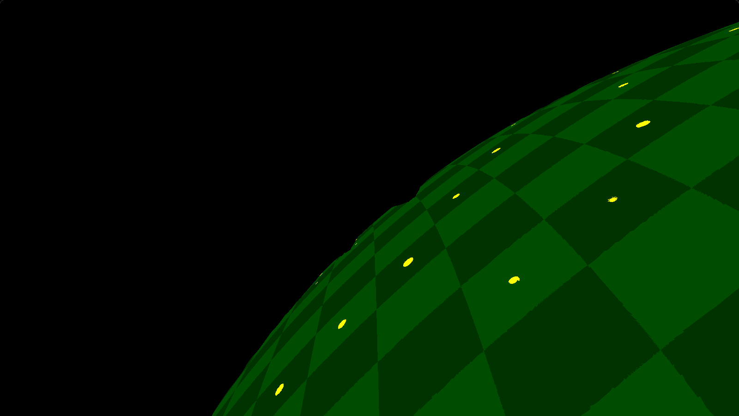
Procedural Sparkles
Algorithm from Shopf: intersect sparkle grid with surface
Notes:
Which produces this

Slide 8
Procedural Sparkles
Finally, a number of offsets are applied to the grid
3D noise
View vector
Time component
Notes:
Finally a number of offsets are applied to the grid
A 3D noise is applied to break up the grid pattern
The view vector is also taken into account to get a sparkly effect when the view changes
We added a time component to maintain the sparkle effect even when the viewpoint is stationary

Slide 9
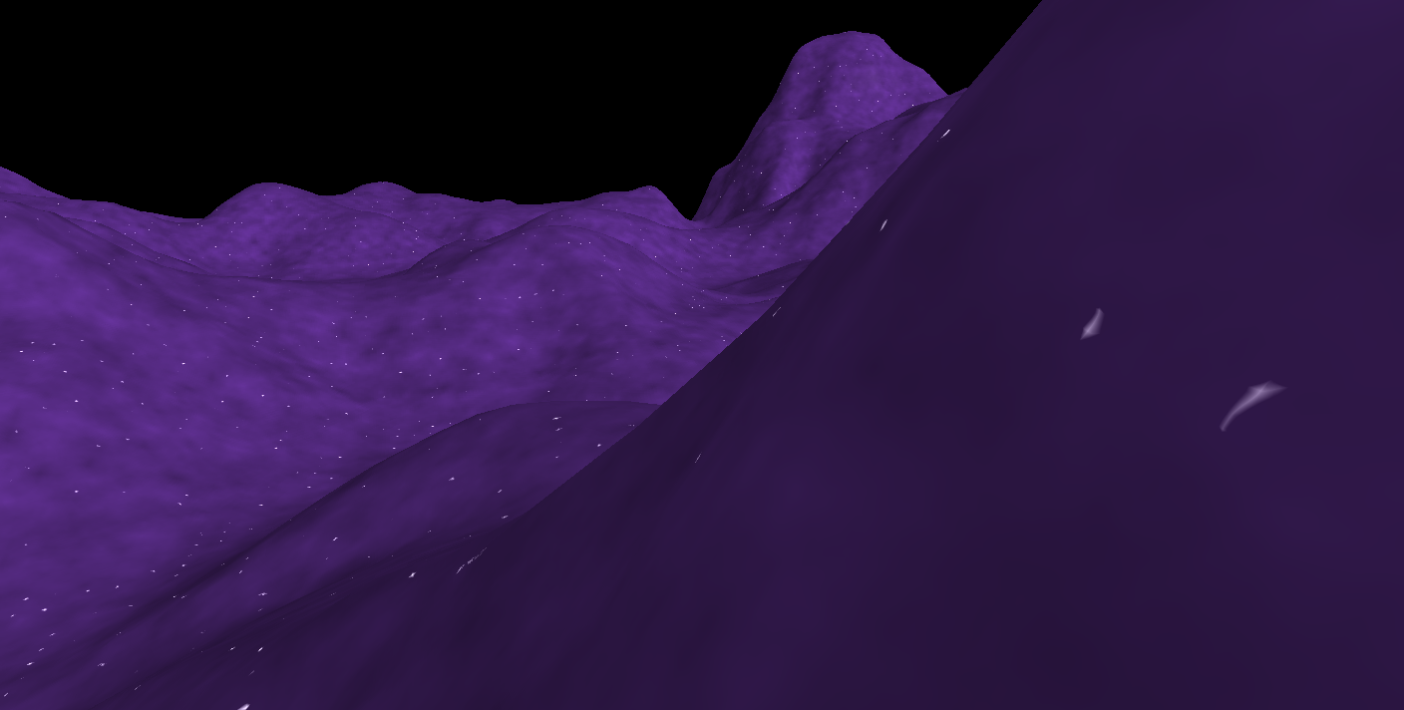
Procedural Sparkles – ISSUES
Notes:
So what were the issues with this algorithm?
First we see the large and distorted shape of sparkles near the viewer.
Next we can see some sharp slithers at shallow viewing angles. These are undersampled and you can see jaggies.
Lastly the sparkles in the background are too small and alias badly under motion. The grid resolution is also unsuitable – we’ll see more of this later.

Slide 10

Procedural Sparkles – ISSUES
Notes:
We can see the problem with the background sparkles best under motion, where we can see them aliasing and flashing. Although it does look sparkly, its too sparkly, we don’t want to have a single sparkle flashing on and off. We want explicit control over how sparkly our sparkles are ☺.
And don’t worry that’s the most times I’m going to say the word sparkle in one slide.

Slide 11
CONTENTS
Sparkle shape
Expanding distance range
Noise distortion
Anisotropy
Notes:
So we are going to address these issues one by one

Slide 12
CONTENTS
Sparkle shape
Expanding distance range
Noise distortion
Anisotropy
Notes:
Starting with the sparkle shape

Slide 13
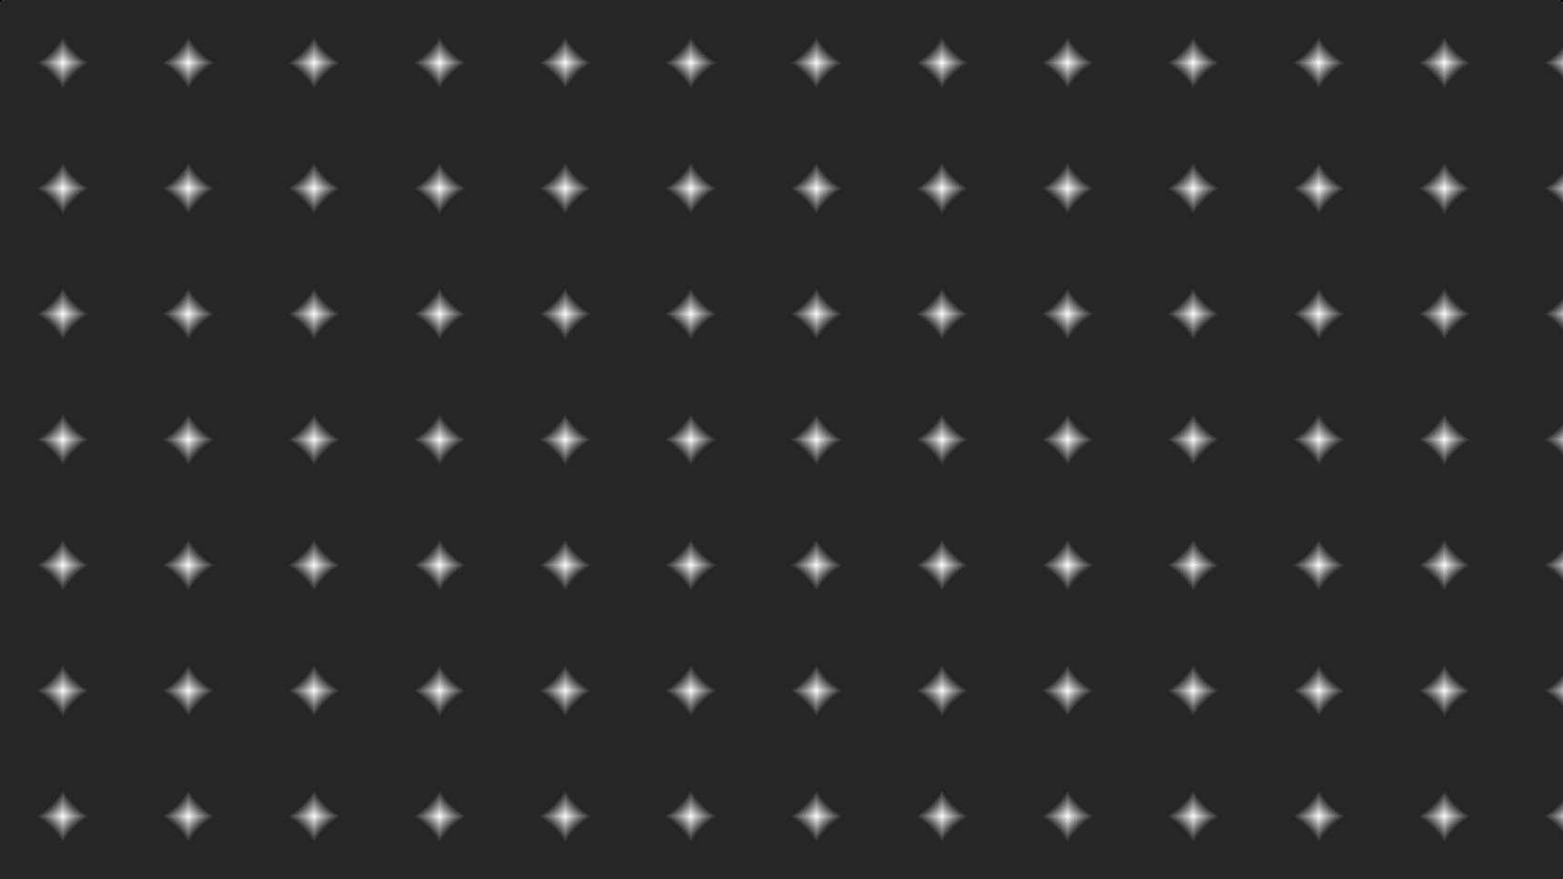
Sparkle Shape
Sharp and pointy
Frequent odd shapes
Does not scale down well
Notes:
So this is what the sparkle shape looks like. It has sharp, pointy features and can produce odd shapes. Its hard to control aliasing for these, especially wben scaled down
See shader here for details: https://www.shadertoy.com/view/llsSW8

Slide 14
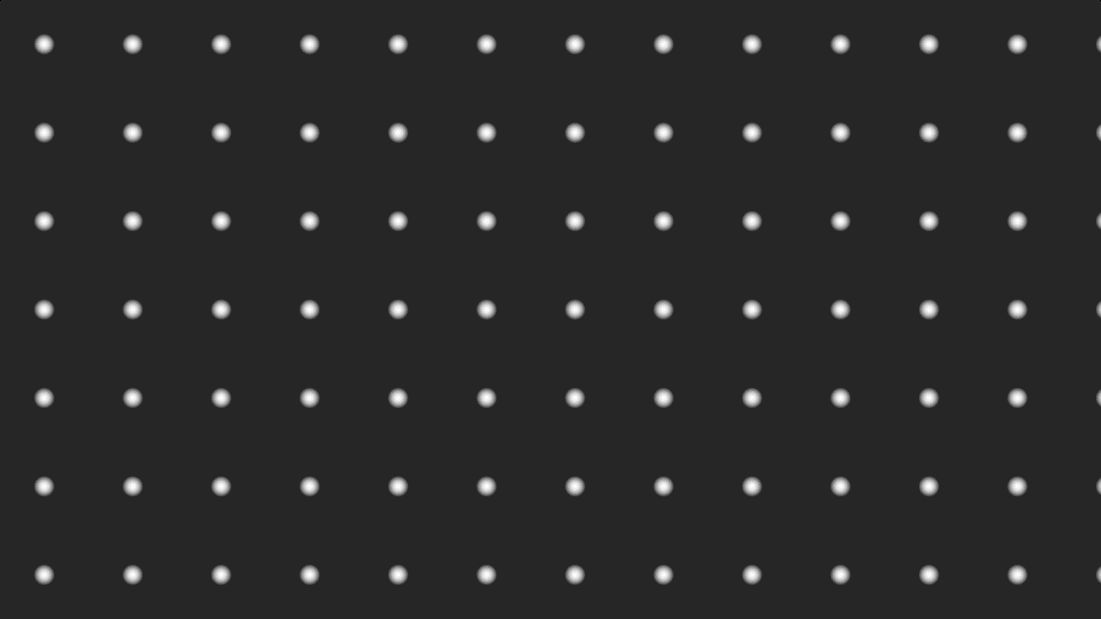
Sparkle Shape
Simply make round
Reduces odd shapes
Scales down well
Simpler
Notes:
Solution – simply make round – scaled square distance from sparkle center
Simple to implement, graceful when scaled down.
See shader here for details: https://www.shadertoy.com/view/llsSW8
(note that we original planned to use something smoother such as a radial smooth step but this seems to work well )

Slide 15
Sparkle Shape – BEFORE
Notes:
Original

Slide 16

Sparkle Shape – AFTER
Notes:
Round. Much more regular shapes. There is still some distortion, we’ll look more at this later.

Slide 17
CONTENTS
Sparkle shape
Expanding distance range
Noise distortion
Anisotropy
Notes:
Next we’re going to look at expanding the distance range that the effect works over.

Slide 18
SPARKLE SIZE
Sparkle size inappropriate outside narrow depth range
Multiply size by Z to compensate for perspective
Notes:
First problem is that the size of the sparkles are in world space and are only appropriate in a narrow depth range.
The obvious fix is to multiply by Z to compensate for perspective.

Slide 19
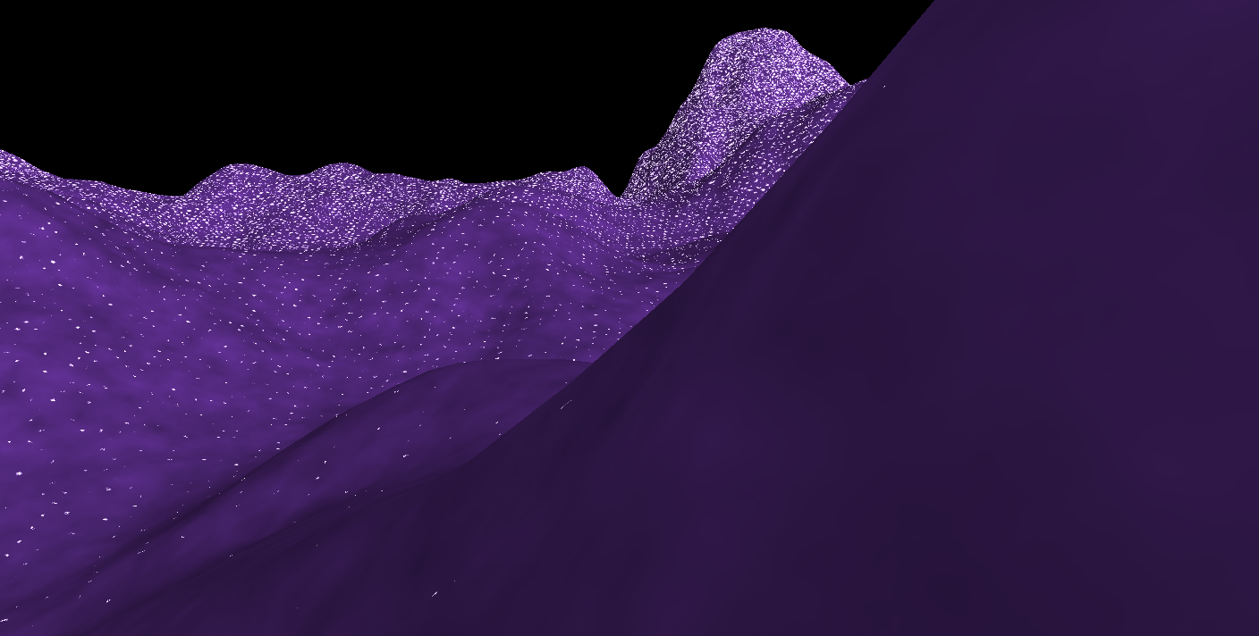
SPARKLE SIZE
Notes:
When we do this we run into another problem – the sparkles quickly outgrow the grid. The grid itself is not suitable in the distance.

Slide 20
GRID SCALING
Could blend multiple grids
Requires multiple sparkle computations
Scale grid based on distance?
Notes:
So we could blend multiple grids, but this would require multiple sparkle computations that we wanted to avoid for performance reasons.
Could we just scale the grid?

Slide 21
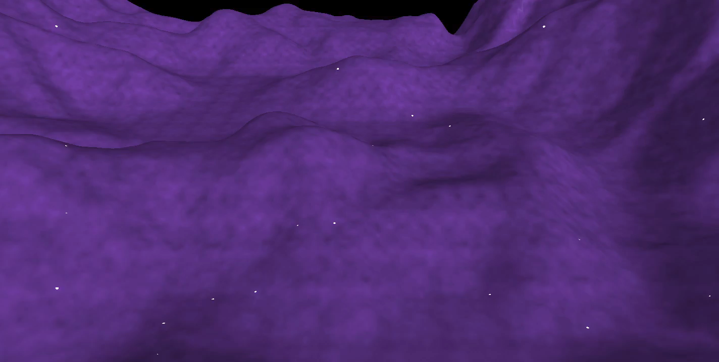
GRID SCALING
Notes:
Naiive approach results in disturbing flickering and motion of the sparkles due to gross expansion or contraction of the grid towards its origin
The further away from the origin you are, the faster the sparkle points move through the world and it really doesn’t work

Slide 22
GRID LEVELS
Solution - step the grid scale
Notes:
To solve this, instead of scaling the grid linearly based on depth, we step the grid scale. This essentially means there are regions where the grid scale was fixed and constant.
The side effect of this is that there is a sharp cut/discontinuity between sparkle densities.
We found that this was not noticeable – it appears as normal sparkling.
(We considered using screen-based noise to break up the boundaries but we found it was not necessary )

Slide 23
GRID LEVELS
Logarithmic steps
Notes:
Finally we used a logarithmic distribution for the levels which is more suitable for projected landscapes.
We chose a logarithm base which worked well so that there weren’t too many cuts between levels near the viewer (1.3)

Slide 24
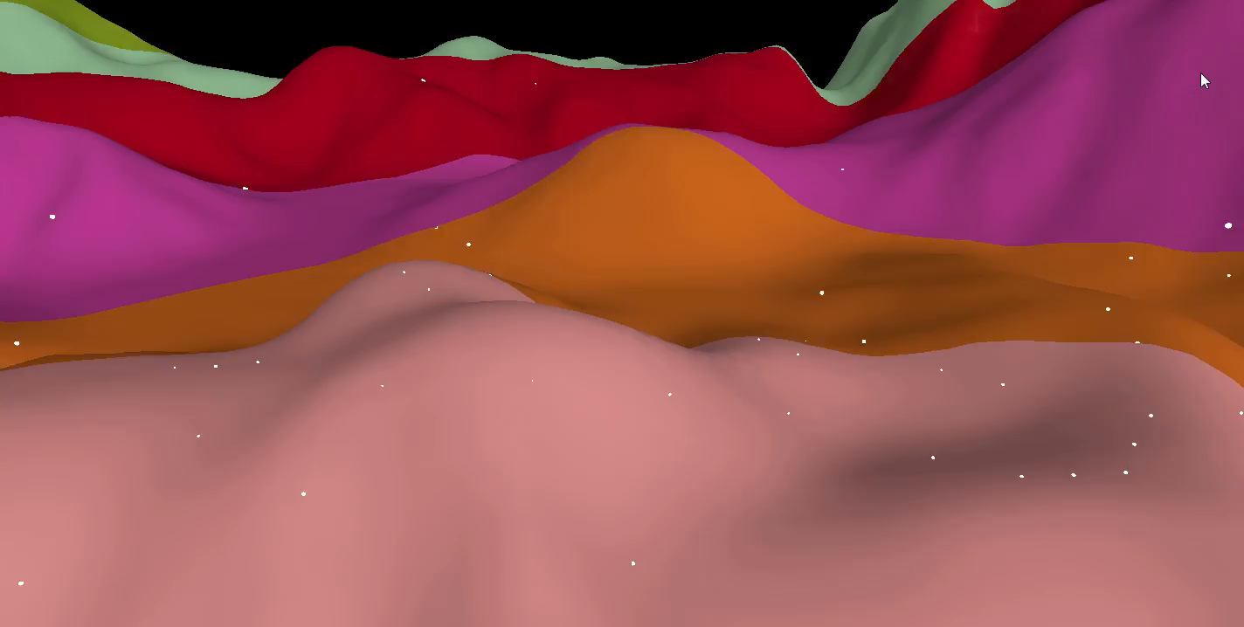
LINEAR GRID LEVELS
Notes:
Here’s a false colour of linear log levels

Slide 25
LOG GRID LEVELS
Notes:
And the logarithmic levels. Not too many in background.

Slide 26
ONE GRID LEVEL
Notes:
Going back to our image from before this is the single grid.

Slide 27

MULTIPLE GRID LEVELS
Notes:
This is multiple grids. This allowed us to have a roughly uniform distribution of sparkles in the foreground and background so that there is visual interest everywhere. The density distribution could also be tweaked.

Slide 28
VIEW DEPENDENCE
We shift the sparkle grid based on the view vector
View vectors (blue) very similar when normalized (green)
Notes:
So as mentioned previously we shift the sparkle grid based on the view vector so that the surface sparkles when the view changes.
In the calculation, the view vector is normalized before being used to offset the grid.
However if the view vector is large, the normalized vectors (shown in green) do not change much under motion, and we see sparkles that don’t change in the background.

Slide 29
VIEW DEPENDENCE
We shift the sparkle grid based on the view vector
View vectors (blue) very similar when normalized (green)
Modulus (orange) before normalisation produces variation in result (green)
Notes:
We solved this issue as follows – we take the modulus of the view vector (orange) before normalising.
This meant that the view dependence worked uniformly in foreground and background.
Again produces discontinuities, but again we didn’t find them noticeable.

Slide 30
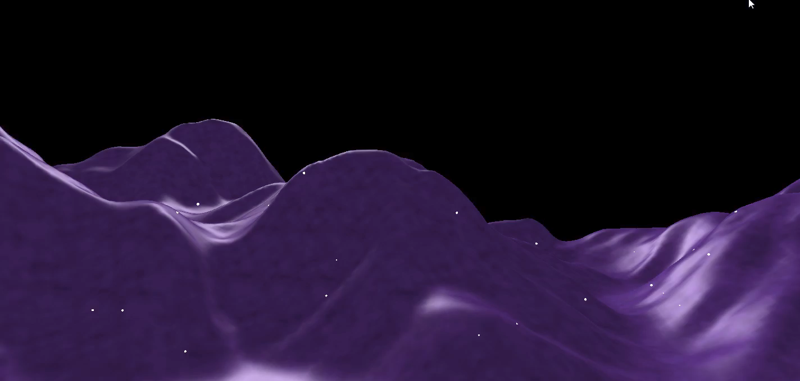
VIEW DEPENDENCE off
Notes:
This is the result with the view dependence off.
Sparkles are not changing in the background.

Slide 31
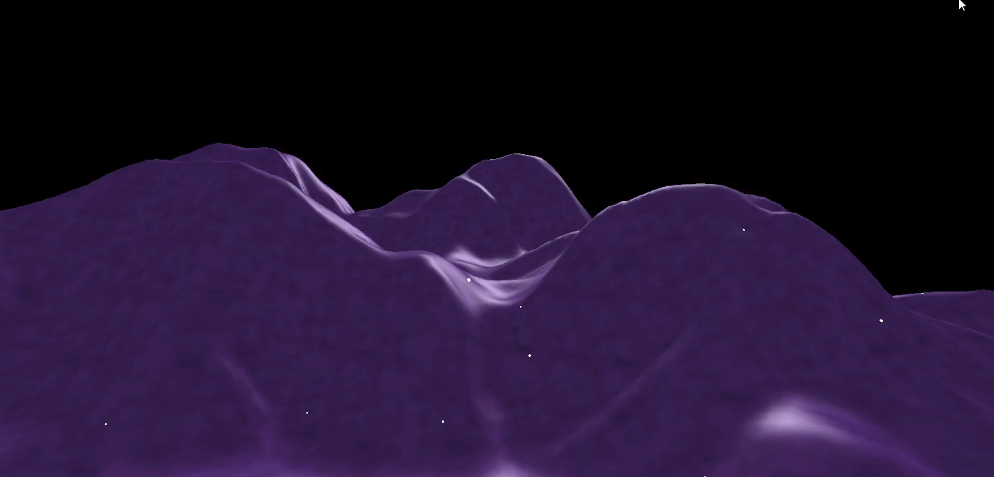
VIEW DEPENDENCE on
Notes:
This is our view dependence.

Slide 32
CONTENTS
Sparkle shape
Expanding distance range
Noise distortion
Anisotropy
Notes:
Next we’ll look at the noise offset.

Slide 33
Noise distortion
Grid look ups jittered by a 3D noise function
Strong compression/expansion of the sparkle shapes
Looks unattractive and makes aliasing difficult to deal with
Notes:
Every look up into the grid is jittered by sampling a 3D noise function.
We found that even a modest noise influence produces strong compression/expansion of the sparkle shapes.
We felt this looked unattractive, but moreover it made aliasing really difficult to deal with.

Slide 34
Noise distortion
Jitter sparkle center only
Compute nearby sparkle grid point and jitter its position
No distortion
Notes:
Instead of jittering the look up, we jitter the center of the sparkle only.
When shading a surface point, we find the nearest sparkle point and then jitter its position.
This way we obtain a clean and distortion free sparkle

Slide 35
Without noise
Notes:
This is what it looks like without any noise offset. Note the strong grid artifacts.

Slide 36
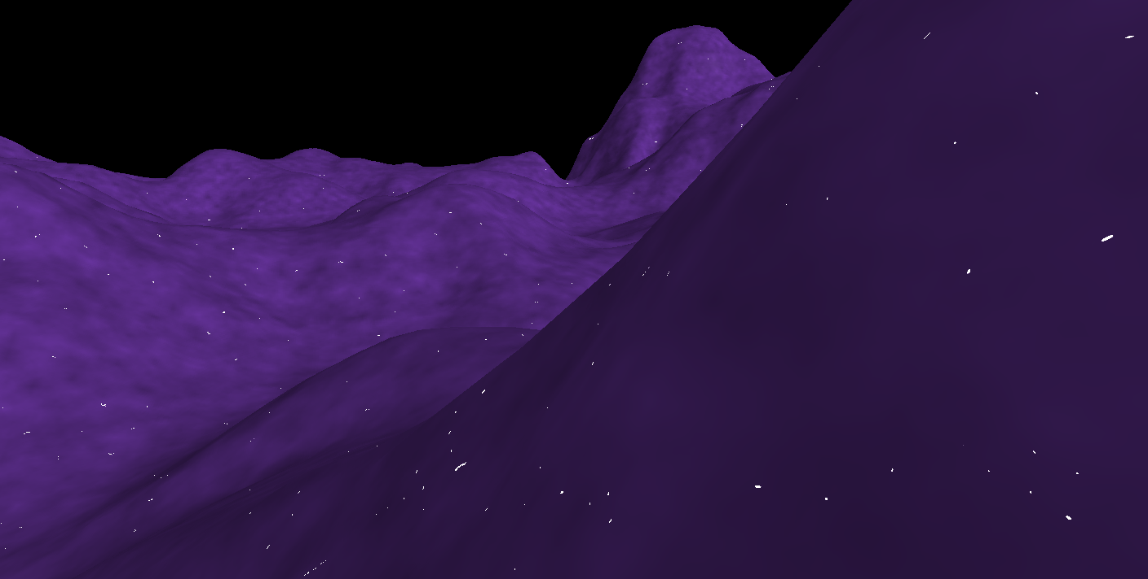
Apply noise to look upS
Notes:
This is the result from jittering every lookup into the grid, where we can get irregular and aliased shapes.

Slide 37

APPLY NOISE TO SPARKLE centeR only
Notes:
Our result jitters only the sparkle center position.

Slide 38
CONTENTS
Sparkle shape
Expanding distance range
Noise distortion
Anisotropy
Notes:
Finally we’re going to add sensitivity to anisotropic sampling.

Slide 39
Anisotropy
Before After
V
V
M
Notes:
The problem is as follows. When the viewing angle is shallow, the sampling rate in one direction is reduced. In this case our sparkle size may be too small in that direction, as above where a sparkle falls between two pixels and will alias.
We could super sample the sparkle grid, similar to anisotropic texture filtering. However a more elegant approach is to change the sparkle kernel to be an ellipse.
The major axis of the ellipse M is the view vector projected onto the surface.
Rather than explicitly model the ellipse, we warp the domain – we shift the grid lookup position along the major axis before evaluating the sparkle kernel. A few things cancelled out and this boiled down to a few linear operations, with no special cases or singularities. See the additional slides for the details.

Slide 40
Anisotropy - before

Slide 41
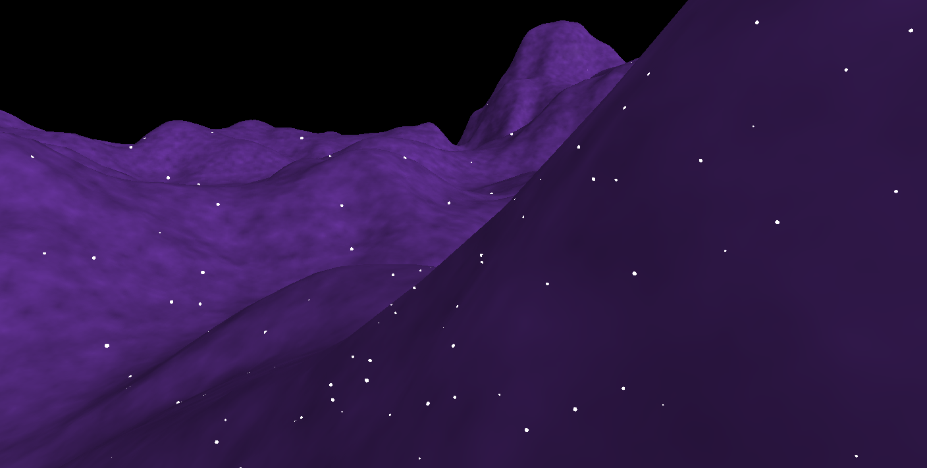
Anisotropy - after
Notes:
Result is striking. Just worked, didn’t need to revisit or tweak this. We’re particularly happy about how well this worked.

Slide 42
RESULT
Notes:
Our result – a stylized approximation

Slide 43
Conclusions
We provide a number of practical improvements to the grid based sparkle algorithm
Boosted flexibility and robustness
Could push sparkle size down
The effect was independent of lighting conditions
Notes:
And now to conclude..
These boosted the flexibility and robustness of the effect. This allowed our artists to apply it to a material and rely on it working. They could also push the sparkle size down to the order of 1-2 pixels.

Slide 44
Conclusions
Important to ensure shading signal is appropriate for the sampling
Our additions provide direct and explicit control over the sparkle size and shape
Notes:
Zooming out, with any procedural effect its important to ensure the shading signal is appropriate for the sampling at all times.
Indeed, most of the effort we invested was to be able to directly control the sparkle size and shape.
We hope this example will generalise to other cases.

Slide 45
References
2012 Shopf, J., Gettin' Procedural, http://amd-dev.wpengine.netdna-cdn.com/wordpress/media/2012/10/Shopf-Procedural.pdf

Slide 46
ACKNOWLEDGEMENTS
Shadertoy + community for knowledge & inspiration
The amazing team that worked on the game that we cannot name
For the conversations and support
Tom Williams, Jim Callin, Kenneth Mitchell
Natalya Tatarchuk for this course!
Notes:
Shadertoy got us thinking along these lines.

Slide 47
Thanks!
Questions?
Please let us know what you think!
Huw Bowles huw@studiogobo.com Shadertoy: huwb
Beibei Wang beibei.wang@studiogobo.com

Slide 48
ADDITIONAL SLIDES

Slide 49
Shader Code
See slide notes
Notes:
uniform sampler3D Noise;//the 3D noise texture
uniform float glitterStrength;//the brighness of the sparkle
uniform vec4 lightDir; //light direction
uniform vec4 color; //color of the surface
varying vec3 vNormal;
varying vec3 vViewVec;
varying vec3 vObjPos;
varying vec4 vlarge_dir;
uniform bool with_anisotropy;//with the anisotropy or not
uniform float i_sparkle_size; //sparkle size
uniform float i_sparkle_density;//sparkle density
uniform float i_noise_density;//the noise density
uniform float i_noise_amount;
uniform float i_view_amount;
uniform float i_time_factor;
uniform float time_0_X;
void main(void)
{
// flip the z for OpenGL.
vec3 ldir = vec3(lightDir.x, lightDir.y, -lightDir.z);
vec3 n_view_dir = normalize(vViewVec);
// Basic lighting
float diffuse = saturate(dot(ldir, vNormal)) + 0.8;
float specBase = saturate(dot(reflect(- n_view_dir, vNormal), ldir));
float specular = pow(specBase, 24.0);
float diffuse_noise = texture3D(Noise, vObjPos * 0.04).x;
vec4 base = (0.5 * diffuse_noise + 0.5) * color;
float noise_dense = i_noise_density;
float grid_sparkle_dense = i_sparkle_density * 15.0;
float adjust_sparkle_size = 1.0 - 0.2 * i_sparkle_size * i_sparkle_density * i_sparkle_density;
//Expanding the distance range, Logarithm Distribution
float zBuf = length(vViewVec);
float z_exp = log2(0.3 * zBuf + 3.0) / 0.37851162325;
float floorlog = floor(z_exp);
float level_zBuf = 0.1 * pow(1.3,floorlog) - 0.2;
float level = 0.12 / level_zBuf;
grid_sparkle_dense *= level;
noise_dense *= level;
//warpping the view vector
float w_view_dir = n_view_dir * level_zBuf;
w_view_dir = sign(w_view_dir) * frac(abs(w_view_dir));
//consider the view direction and the time
float time = 0.2 * abs(frac(time_0_X * i_time_factor) - 0.5);
vec3 pos_with_view = grid_sparkle_dense * vObjPos + time + i_view_amount * normalize(w_view_dir);
//generate the grid
vec3 grid_index = floor(pos_with_view);
vec3 grid_offset = pos_with_view - grid_index;
float grid_length = 1.0 / grid_sparkle_dense;
vec3 grid_center = grid_index * grid_length;
//jitter the grid center
float jitter_noisy = i_noise_amount * texture3D(Noise, noise_dense * grid_center).x;
vec3 jitter_grid = vec3(jitter_noisy);
jitter_grid = 0.5 * frac(jitter_grid + 0.5) - vec3(0.75,0.75,0.75);
vec3 new_offset = grid_offset + jitter_grid;
//Anisotropy
float dotvn = vlarge_dir.w;
vec3 large_dir = vlarge_dir.xyz;
if(with_anisotropy)
new_offset += (abs(dotvn) - 1.0) * dot(new_offset,large_dir) * large_dir / dot(large_dir,large_dir);
//compute the brightness of the sparkle according to the offset
float l2 = dot(new_offset, new_offset);
float m_ss = 1.0 - adjust_sparkle_size;
float glittering = 0.0;
if(m_ss > l2)
{
float lend = ((1.0 - l2) - adjust_sparkle_size) / (1.0 - adjust_sparkle_size);
glittering = 20.0 * lend;
}
gl_FragColor = base * diffuse + 0.5 * specular + glitterStrength * glittering;
}

Slide 50
Anisotropy
Project the view vector V onto the surface to get a new vector M which will be the major axis of the elliptical sparkle shape
M = V – dot(V,N)*N
N
V
M

Slide 51
Anisotropy
Before After
Let X denote lookup offset from sparkle center
Project X onto major axis: X_M = dot(X,M)*M
Shift X along this axis: X -= (1.0 - abs(dot(V,N))) * X_M
N
N
V
V
M
M
Notes:
Instead of distorting range of sparkle kernel, distort domain instead (shift lookup pos relative to sparkle, instead of changing sparkle itself). So we change the domain instead of the range.
Boils down to a few simple linear operations!

Slide 52
Fast floor log2
An obscure result thrown in for fun
For our grid scale levels computation, the level index was given by
floor(log(depth))
For base 2, this is exactly the exponent stored in a IEEE float, which can be unpacked as follows, assuming inp is positive: float fastfloorlog2( float inp ) { return (floatBitsToInt( inp ) >> 23) - 127.0; }
Notes:
This needs a relatively new shader model (I believe SM4)
This requires a positive input. Negative or zero inputs could be special cased if necessary.

